Slide 1
Subversion (SVN) Tutorial for CS421
Dan Fleck
Spring 2010

Slide 2
What is version control?
Version management allows you to control and monitor changes to files
  What changes were made?
  Revert to pervious versions
  When were changes made
  What code was present in release 2.7?
Earliest tools were around 1972 (SCCS)
Older tools – RCS, CVS, Microsoft Source Safe, PVCS Version Manager, etc…
Current tools – Subversion, Mercurial, Git, Bazaar

Slide 3
We will use subversion (svn)
Why?
Because it’s popular
It’s well supported
  IDEs - Netbeans, Eclipse
  Numerous GUI tools
  Command line
  XP Dev has support for it (you will use this for your semester projects)

Slide 4
subversion concepts
checkout – get a local copy of the files
  I have no files yet, how do I get them?
add – add a new file into the repository
  I created a new file and want to check it in
commit – send locally modified files to the repository
  I’ve made changes, how do I send them to the group?
update – update all files with latest changes
  Other people made changes, how do I get them?
tag / branch – label a “release”
  I want to “turn in” a set of files

Slide 5
Creating a new repository
Command Line:
  Open command prompt
  Go to a directory where you want your files to be stored
  svn checkout <<location>>/svn/<<your project>>/
GUI Mac OSX SCPlugin
  Adds commands to right-click menu in Finder
GUI Windows Tortoise SVN
  Adds commands to right-click menu in Explorer

Slide 6
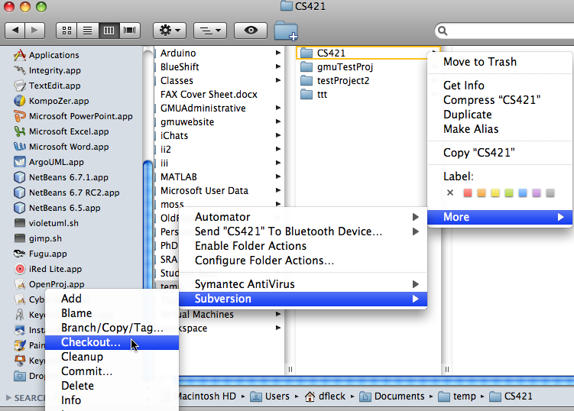
Creating a new repository - Mac SCPlugin

Slide 7
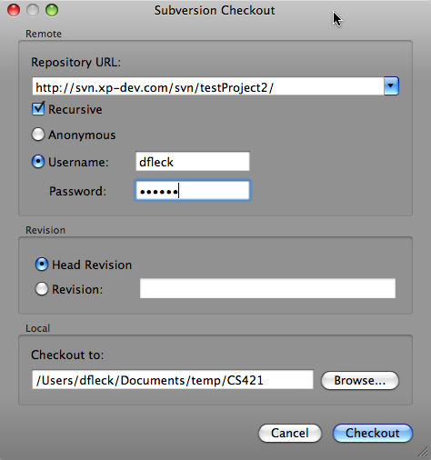
Create Repository – Mac OSX

Slide 8
Create a repository using Tortoise SVN
I need a tool that allows Windows screenshots with a timer.
See: http://tortoisesvn.tigris.org/ExplorerIntegration.html#contextmenus
Open Windows Explorer
Select a directory where you want your repository
Right-click and select “Create Repository Here…”

Slide 9
Add a file into repository
Copy a new file into the “trunk” directory
Tell SVN to include the file as part of the repository
  Command line
    svn add yourFile.ppt
  GUI
    Windows: right click choose: TortoiseSVN->Add
    Mac OSX: right click choose:More->Subversion->Add
This does NOT upload the file yet! The commit command will upload all new files and changed files

Slide 10
Commit changes
Modify a file contained in your repository
Command Line:
  svn commit -m ’Added a new sequence diagram.’
GUI
    Windows: right click choose: TortoiseSVN->commit
    Mac OSX: right click choose:More->Subversion->commit
    Update the message with what was changed in the file. This should be a meaningful statement someone can look at to determine what was changed

Slide 11
Update
Update gets all new changes from the repository.
  svn update
  GUI Users: you should get it by now
What happens if there is a conflict?
  User A has version 3 of the file, modifies it, commits it creating version 4.
  User B has version 3 of the file, modifies it, commits it
    CONFLICT – User B’s copy of the file was out of date. User B must merge their changes into Version 4
  For text files (like source code) SVN can help do this in an automated way
  For binary files SVN cannot help… must be done manually
Lesson: Always ensure you have the latest version (update frequently). If multiple people are editing the same file you could have problems

Slide 12
Summary – Checking things in
Create the repository by “svn checkout”
Copy your documents into “trunk” directory
Use “svn add” to mark files to include in the repository
  Use “svn commit” to send the files to the repository
Modify files, “svn commit” as needed until your deliverable is complete
svn commit (don’t forget the final commit!)

Slide 13
Other notes
log command shows the log of changes to a file
diff command can shows changes between revisions (for text files only)
These commands are all built-in to IDEs: eclipse, netbeans
Mac Users: the SVN command line that is bundled with Mac (at least Leopard) is old (and wasn’t compatible for SCPlugin). You can update the command line tool at :
http://www.open.collab.net/downloads/subversion.html

Slide 14
SVN example
Checkout:
  Let’s try it with the test project for this class at
  https://svn3.xp-dev.com/svn/cs421_spring2011/
  Note this is the SSH link (https)
Edit a file
commit
add
update

